Slide 1

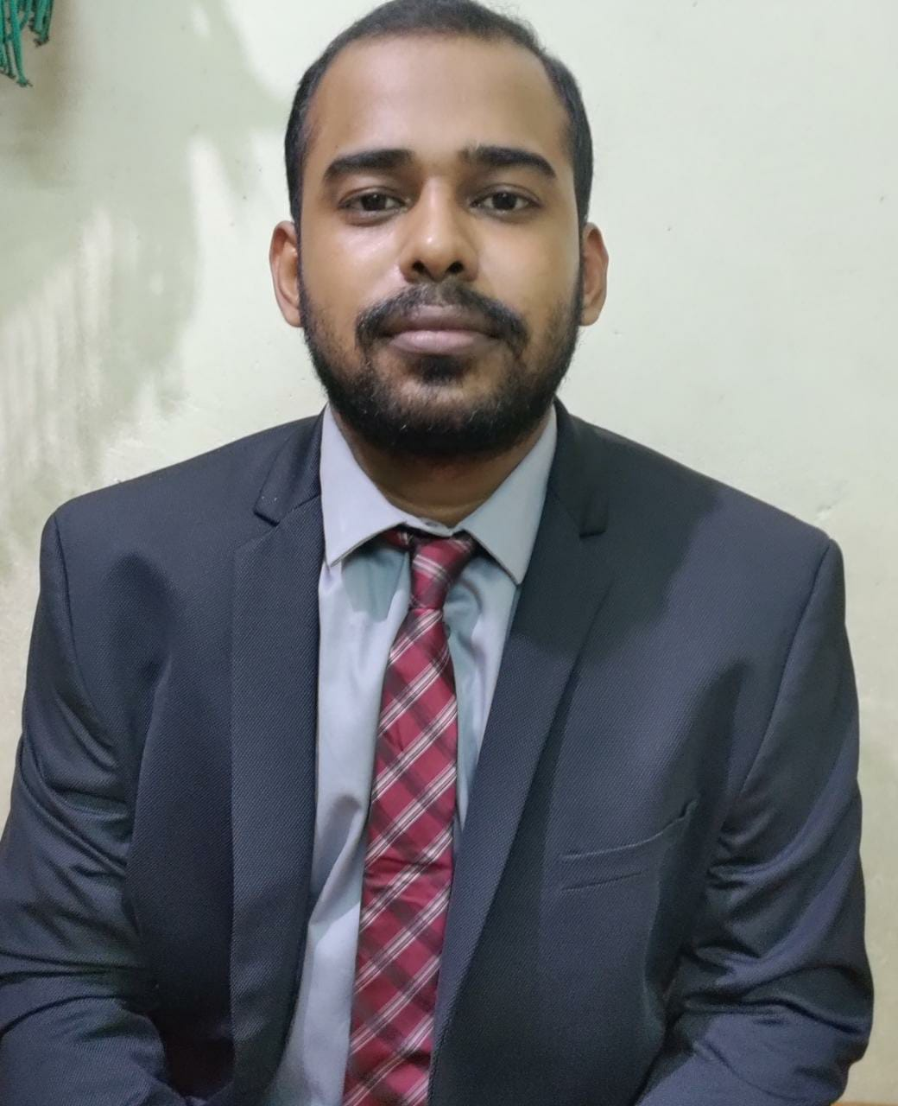
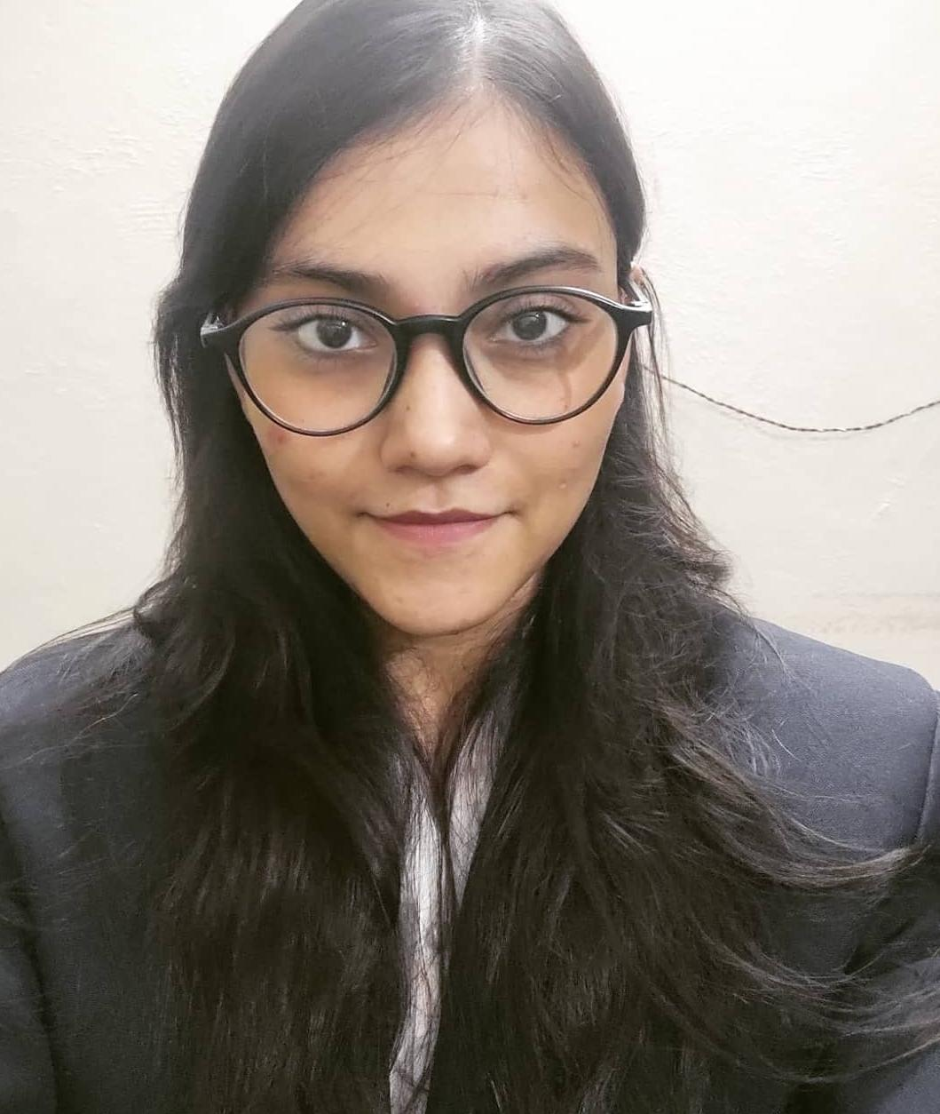
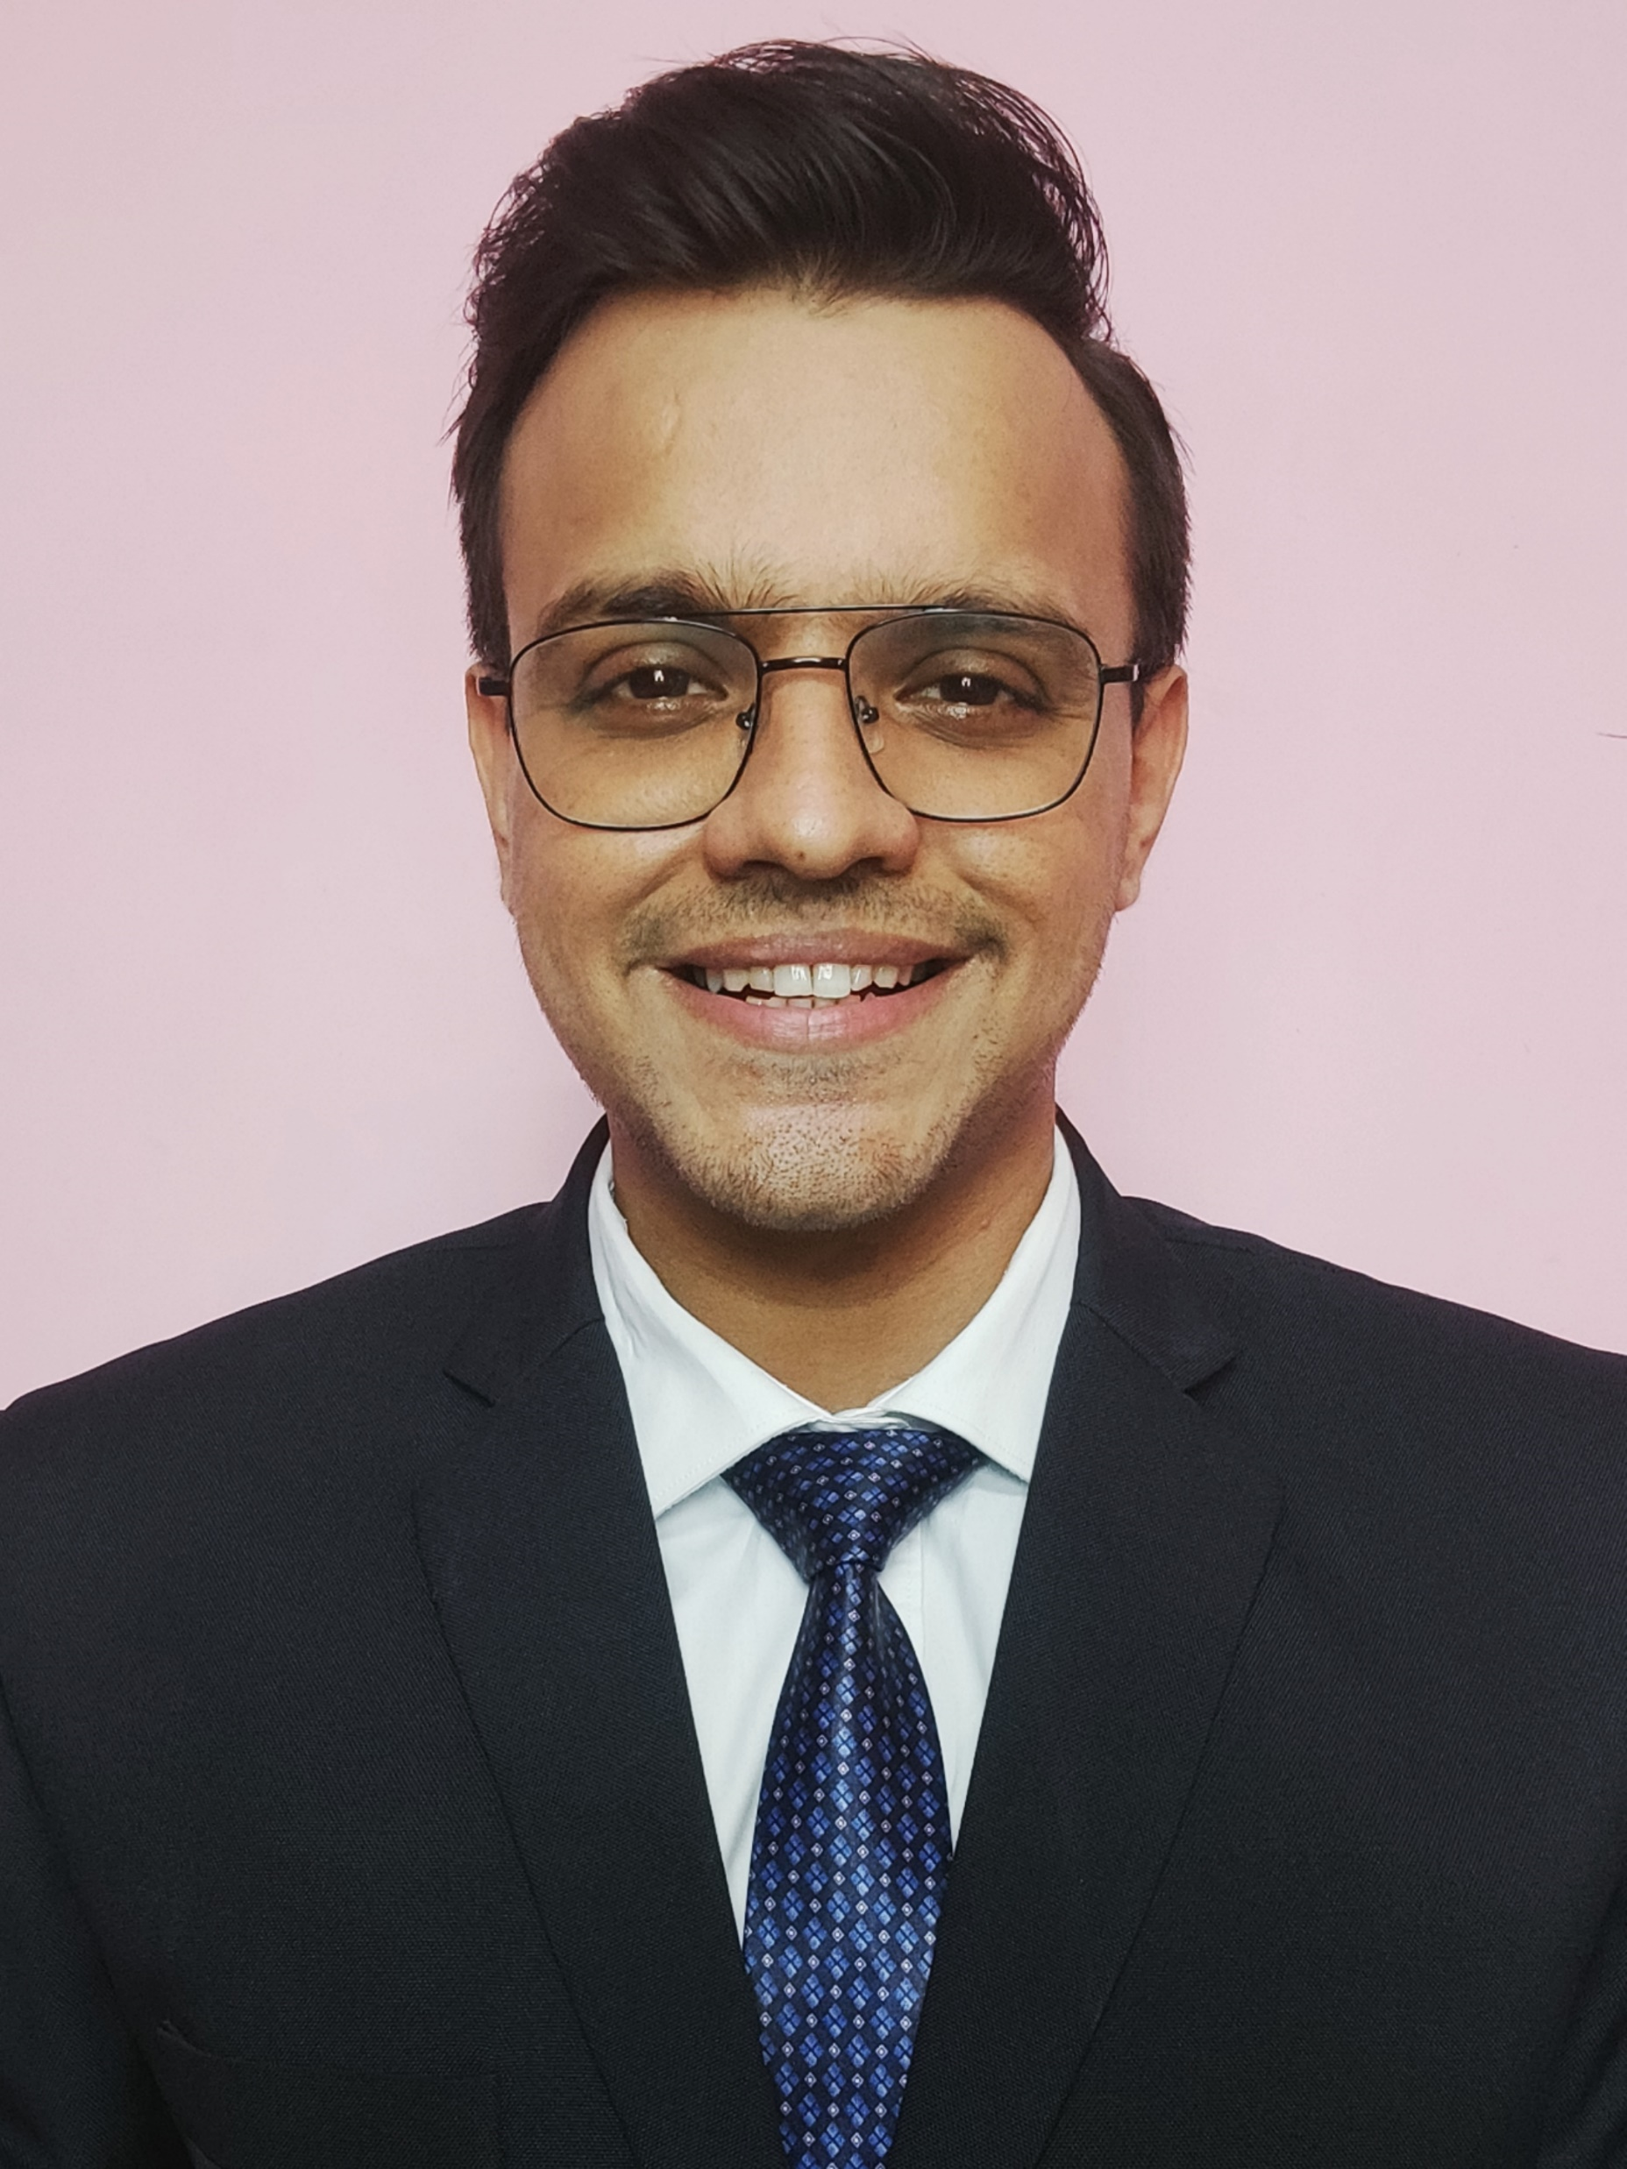
Entrée-preneurship 4.0
Team Sorted
Devesh Sinha Kajal Gupta Mohit Kiradoo
T. A. Pai Management Institute

Slide 2





Company Highlights
The Sector
The Platform
About Dare2Compete
Founded in 2016 by Mr. Ankit Aggarwal, D2C allows businesses to communicate with students, professionals, and employees in the most engaging way possible
It is an easy-to-use website with value added services
Its vision is to create a platform where colleges and management students could interact, share and compete
Business Model
B2B :
Client Segment : EdTech/Education, Services, Recruitment, Education, Technology
Target companies : Startup, Medium Enterprise, Large Enterprise, Small Enterprise
B2C :
User age :18 – 25, 26 -34, 35 - 45
User Personas: Students, Professionals
Key Activities
For Students - conducts Competitions, Quizzes, Hackathons, Business Simulation Games, Internships, Scholarships and many more
For Companies - Dare2Compete acts as an employer branding consultant for enhancing the company's brand visibility, brand engagement and brand equity across campuses in India
Revenue stream
E-Commerce Product
Advertising
Commission on transaction
Subscription
Channels
Emails
Host simulation games for competition
Social Media
Customized college pages on D2C website
Large user database
Student and corporate community
User friendly platform
Low CAC
One stop platform
Weakness
Less awareness about the D2C mobile app
Sometimes the reachability to the host of the competition on the website is not very feasible
SWOT
Strengths
Large user base
User friendly platform
Low cost
Great brand value
One stop platform
Diversified revenue stream
Core competencies
Opportunities
Increase mobile presence
Freelancing
Increase in user engagement
Threats.
potential competitors may gain entry in the market

Slide 3



Company Highlights
The Sector
The Platform
The new sector where Dare2Compete can pivot there business is – FREELANCING MARKETPLACE
About the sector
2nd India fastest-growing freelance market in the world
15 mn estimated freelancers
$20-25 bn Estimated market cap by 2025
High demand from start-ups and corporates for projects
Indian freelancers work for an average hourly rate of $18, while globally the average hourly rate is $21.
GAP
Not choosing the right professional
High charges and additional costs
Prevalence of fraud sellers
Commission charges
Fake reviews about the sellers
Poor insight on past performance
Poor integration into existing teams
Communication gap
Recent Trends
Increasing Number of Corporate Professionals in India are Turning Freelancers
Increase in Number of Part-time Freelancers
Large Number of Indian Women are Becoming Freelancers
Pandemic- boost to the freelancing segment
Market Sizing
Tier 1
Tier 2
Tier 3 and below
Estimating the tentative market size of Dare2compete, using the top to bottom approach
Total number of engineering seats= 15 lakh
% of students getting admitted=70% = approx. 10 lakh
Total number of post graduate management seats = 2 lakh
From Engineering colleges
% getting admitted
0.5%
30%
20%
% of active users
40%
25%
10%
Assumptions:
Major chunk of the users on the platform are from B-schools and Engineering colleges
Approximately 30% of the all India seats in engineering remain vacant
Breakup of students admitted to Tier1, Tier 2 and Tier 3 and below are considered based on the %ile cut-offs for these categories
Tier 1 and Tier 2 colleges are considered to have higher users because of the higher participation observed from these colleges
The users of the platform are relatively low in engineering colleges as compared to B-Schools, considering the type of competitions and challenges being hosted
A small % of users are also observed to be from other non-engineering and non-management courses and some corporates are also observed to be participating in many events
Total active users(in 000s)
20
75
70
From B-Schools
% getting admitted
0.5%
20%
80 %
% of active users
70%
40%
20%
Total active users(in 000s)
7
16
34
Total active users in these two categories
2 lakh
% of users from other categories
10%
Total active users on the platform
2.2 lakh

Slide 4
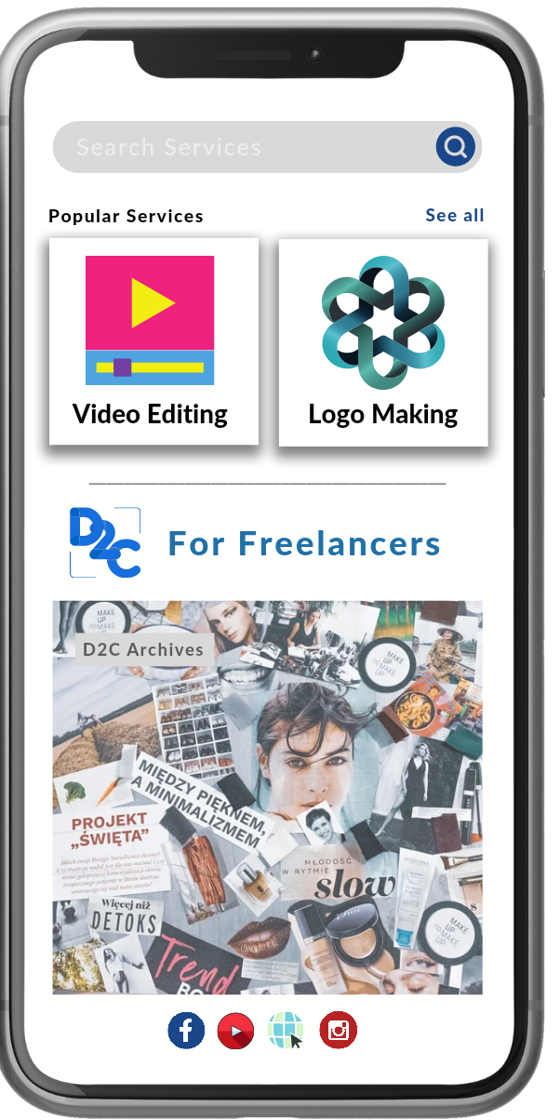




Company Highlights
The Sector
The Platform
For Freelancers
Revenue Model of D2C for Freelancers
Freelancer’s Side | Client’s Side
Fees charged by freelancers for services based on customer classification. | A monthly subscription fee for Premium clients.
Contract with Non-Enterprise Client — Each Non-Enterprise Client is paid a sliding cost based on lifetime billings. Whether the contracts are hourly, fixed-price, or Project Catalogue projects, the service fees remain the same. | Customized pricing depending on the level of service that will be provided
Contracts with Enterprise Clients — These sliding fees do not apply to Enterprise client contracts. The service cost for enterprise contracts is a fixed 10%. Enterprise clients are identified by a badge on their client profiles. | A percentage of payments processing and administration costs on all payments
marketplace for all the Indian Freelancers connecting them with Indian and Foreign clients
create their portfolio in the D2C for Freelancers platform
User friendly interface providing top notch user experience
Students/freelancers will encourage new developments by their favorite platform
Cost Allocation
Assuming that the Portal website and application to be built by the inhouse developers of D2C as a part of the new project at an additional cost ₹1,00,000 for the project including additional domain name, certificates, servers etc.
The Operations costs include the IT operations and maintenance of the Portal to be outsourced at a cost of ₹1,00,000 per month.
The Marketing cost includes digital advertisements, collaborations, launch event, PR and other miscellaneous costs as ₹2,00,000
Keeping the buffer of ₹1,00,000 In hand for liquidity and other impromptu costs.
Note: This cost allocation considers the initial setup and introductory period of D2C for freelancers with a gradual growth this business will be in the eyes of D2C’s investors and other Investors. To further scale up the business an investment of at least ₹50,00,000 for the next operations cycle is desired.
For Freelancers
In the Future
Many businesses and organisations choose remote working as we move deeper into the digital age and how the epidemic has impacted enterprises.
Freelancers are ahead of the curve; with firms throughout the world automating many of their functions and expanding their reach through online platforms, the prospect of an even larger freelancing market looms.
In such a circumstance, a talent marketplace's business model, such as D2C for Freelancers, is critical in assisting businesses in obtaining the essential workforce and talent from anywhere in the globe.

Slide 5
THANK YOU!

